Slide 1
Food Survey Analysis
By
Aquib Rahmani

Slide 2


Slide 3
Introduction
I'm excited to show you what we found in our recent survey about food during COVID-19. We used Google Forms to ask people about what they're eating these days. Our survey is like a treasure trove of food choices and what people like. And guess what? The information we collected helped us discover some really cool things. The survey not only tells us about food choices but also shows us how our feelings about food have changed during these times.

Slide 4
Data Collection
I'm delighted to share with you the results of a recent survey that delves into how the COVID-19 pandemic has influenced our food habits. We utilized a Google Form to gather responses from individuals, asking pertinent questions to understand the shifts in their eating patterns post-COVID.
This survey serves as a valuable tool for exploring the impact of the pandemic on our dietary choices and habits. We'll navigate through the collected data to unveil the various ways in which people's food preferences and routines have evolved in the aftermath of COVID-19.

Slide 5
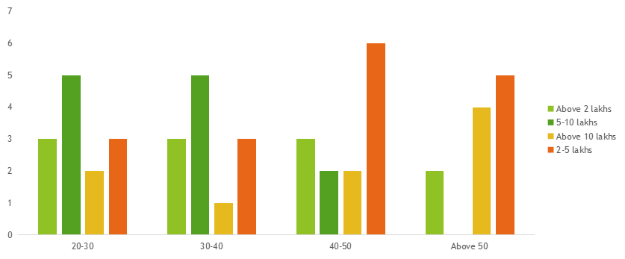
What type of food did they consume more before the pandemic?
The data indicates a predominant trend among individuals aged 40-50, showing a prevalent preference for healthy food choices within the income bracket of 2-5 lakhs.

Slide 6
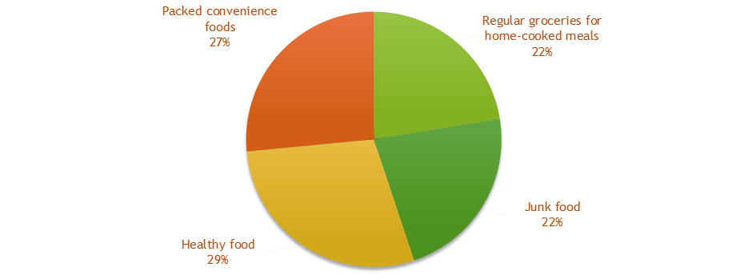
Which type of food did they purchase more before the pandemic?
The majority of individuals exhibit a preference for healthy food across all age groups.

Slide 7
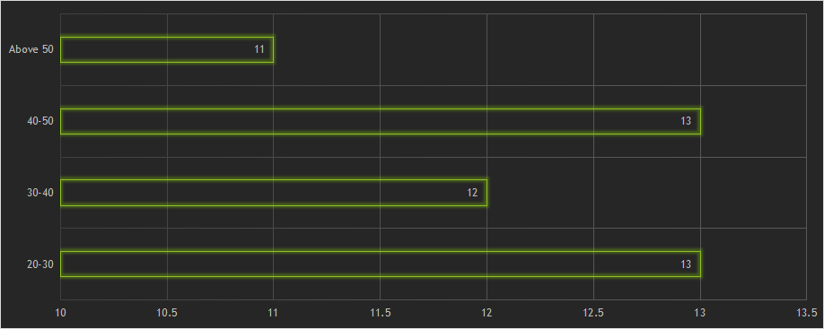
Have they experienced any impact from COVID-19?
The age groups most significantly affected by COVID-19 are 20-30 and 40-50.

Slide 8
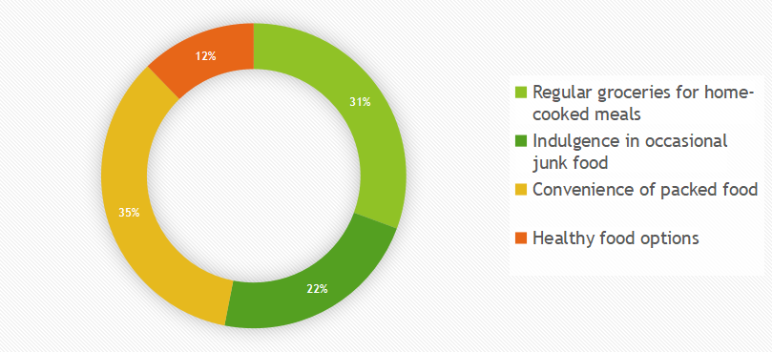
What type of food they prefer more during or after COVID-19?
Post-COVID-19, there is a notable preference for the convenience of packed food across all age groups.

Slide 9
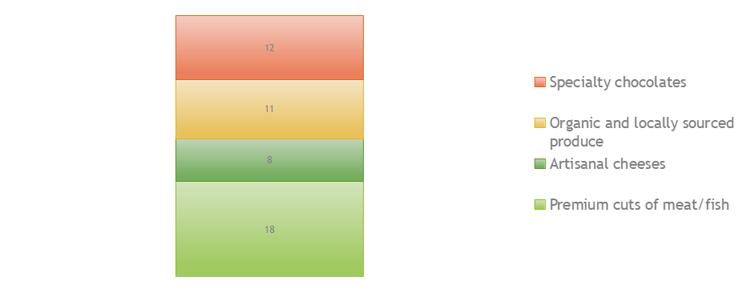
How much money they spend on groceries per week?
Following the COVID-19 pandemic, there is a predominant preference for premium cuts of meat/fish, and subsequently, there is a shift towards favoring specialty chocolates among most people.

Slide 10

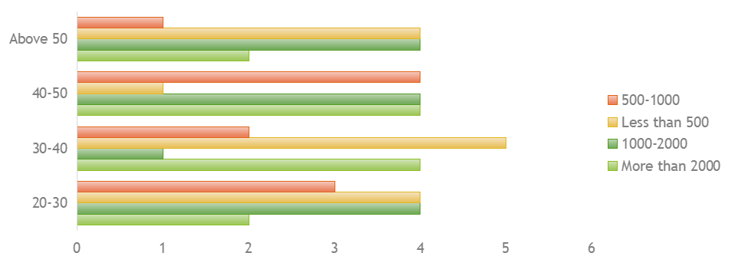
Individuals in the age groups of 30-40 and 40-50 tend to spend more than 2000 per week, while those within the age group of 30-40 spend less than 500 on groceries.

Slide 11
Thank You

